Slide 1
CSCI 631 Foundations of Computer Vision
Ifeoma Nwogu
ion@cs.rit.edu
Lecture – Local features

Slide 2
Overview
Corners (Harris Detector)
Blobs
Descriptors (SIFT)

Slide 3
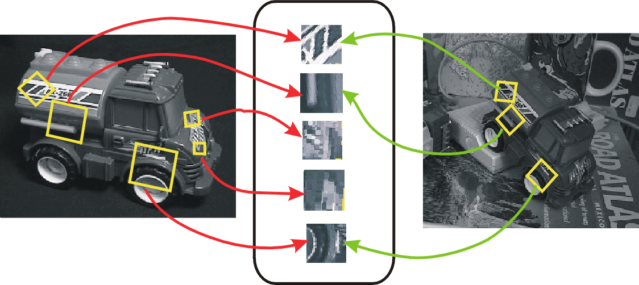
From feature detection to feature description
Detection is covariant:
features(transform(image)) =transform(features(image))
Description is invariant:
features(transform(image)) = features(image)

Slide 4
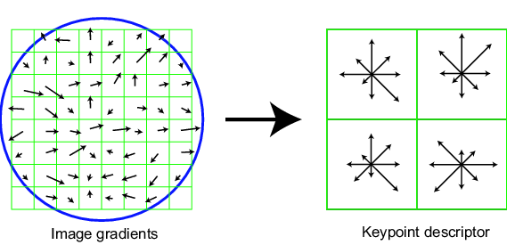
Scale Invariant Feature Transform
David Lowe IJCV 2004
Basic idea:
Take 16x16 square window around detected feature
Compute edge orientation (angle of the gradient - 90°) for each pixel
Throw out weak edges (threshold gradient magnitude)
Create histogram of surviving edge orientations
0
2π
angle histogram
Adapted from slide by David Lowe

Slide 5
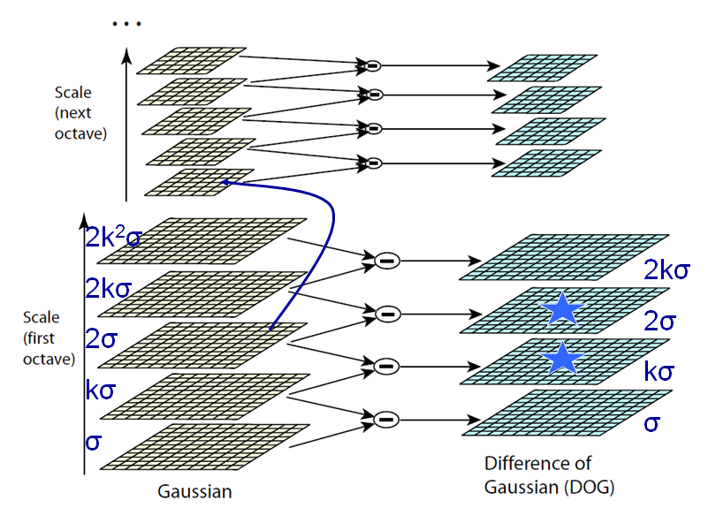
Efficient implementation
David G. Lowe. "Distinctive image features from scale-invariant keypoints.” IJCV 60 (2), pp. 91-110, 2004.

Slide 6
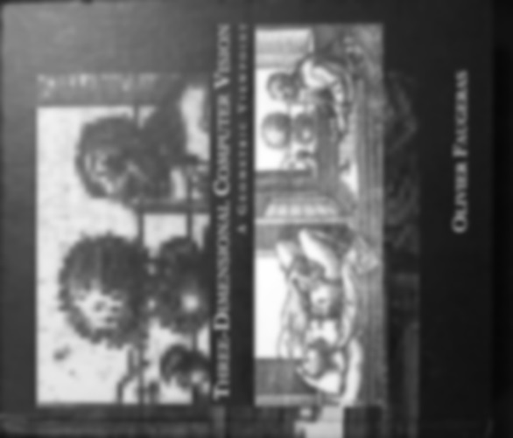

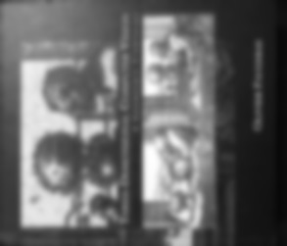





Scale space images
…
…
…
…
…
first octave
…
second octave
…
third octave
…
fourth octave

Slide 7
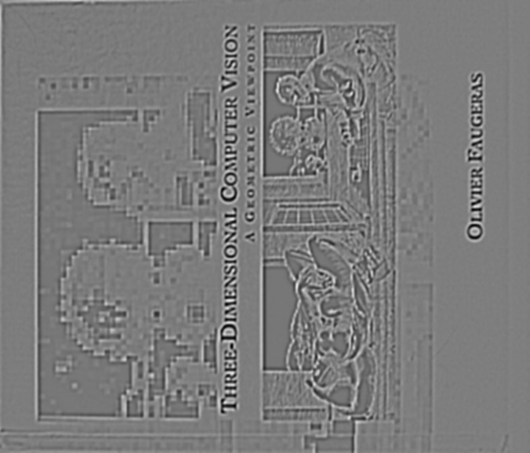
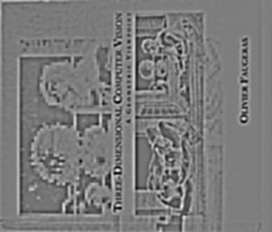
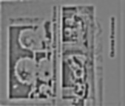

Difference-of-Gaussian images
…
…
…
…
…
first octave
…
second octave
…
third octave
…
fourth octave

Slide 8
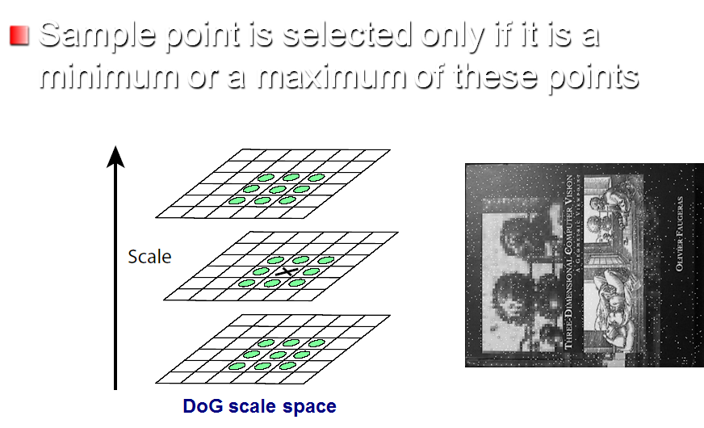
Finding extrema
Extrema in this image

Slide 9
Localization
3D quadratic function is fit to the local sample points
Start with Taylor expansion with sample point as the origin
where
Take the derivative with respect to X, and set it to 0, giving
is the location of the keypoint
This is a 3x3 linear system

Slide 10
Localization
Derivatives approximated by finite differences,
example:
If X is > 0.5 in any dimension, process repeated

Slide 11
Filtering
Contrast (use prev. equation):
If | D(X) | < 0.03, throw it out
Edgeiness:
Use ratio of principal curvatures to throw out poorly defined peaks
Curvatures come from Hessian:
Ratio of Trace(H)² and Determinant(H)
If ratio > (r+1)²/(r), throw it out (SIFT uses r=10)

Slide 12
Orientation assignment
Descriptor computed relative to keypoint’s orientation achieves rotation invariance
Precomputed along with mag. for all levels (useful in descriptor computation)
Multiple orientations assigned to keypoints from an orientation histogram
Significantly improve stability of matching

Slide 13
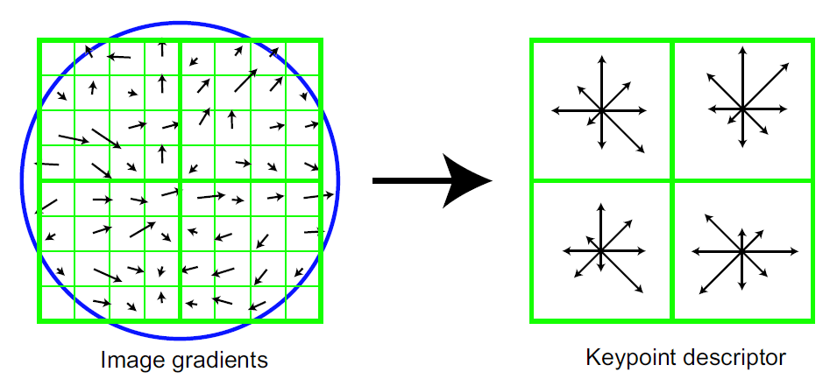
Descriptor
Descriptor has 3 dimensions (x,y,θ)
Orientation histogram of gradient magnitudes
Position and orientation of each gradient sample rotated relative to keypoint orientation

Slide 14
Descriptor
Weight magnitude of each sample point by Gaussian weighting function
Distribute each sample to adjacent bins by trilinear interpolation (avoids boundary effects)

Slide 15
Descriptor
Best results achieved with 4x4x8 = 128 descriptor size
Normalize to unit length
Reduces effect of illumination change
Cap each element to 0.2, normalize again
Reduces non-linear illumination changes
0.2 determined experimentally

Slide 16
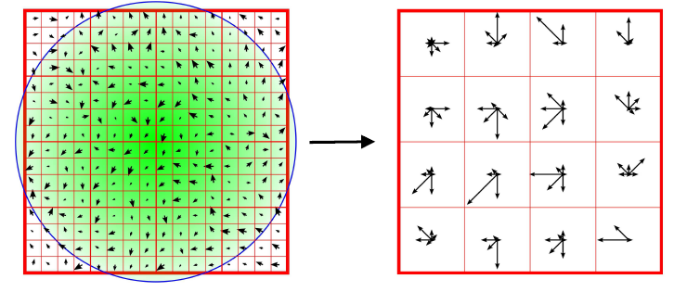
Orientation Histogram
4x4 spatial bins (16 bins total)
Gaussian center-weighting
8-bin orientation histogram per bin
8 x 16 = 128 dimensions total
Normalized to unit norm

Slide 17
SIFT features
Very strong record of effectiveness in matching applications
use orientations to suppress intensity change effects
use histograms so neighborhood need not be exactly localized
weight large gradients higher than small gradients
Weighting processes are different
SIFT features behave very well using nearest neighbors matching
i.e. the nearest neighbor to a query patch is usually a matching patch

Slide 18
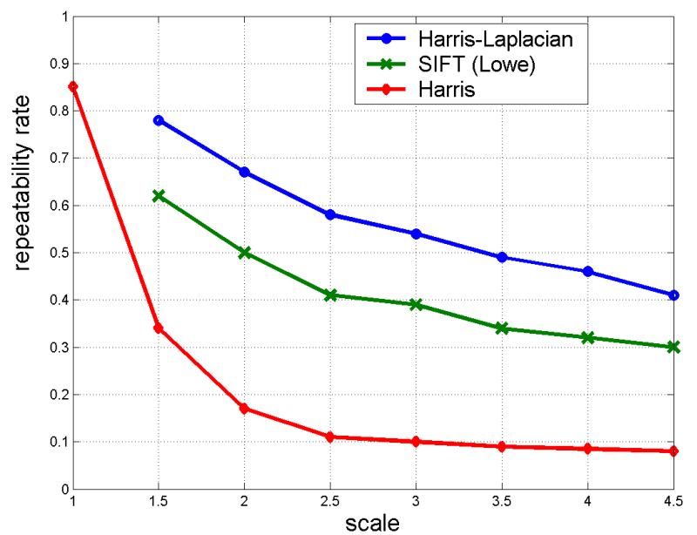
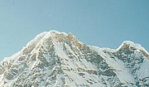

Scale Invariant Detectors
Experimental evaluation of detectors w.r.t. scale change
Repeatability rate:
# correspondences # possible correspondences
K.Mikolajczyk, C.Schmid. “Indexing Based on Scale Invariant Interest Points”. ICCV 2001

Slide 19
Neighborhoods and SIFT - Key Points
Algorithms to find neighborhoods
Represented by location, scale and orientation
Neighborhood is covariant
If image is translated, scaled, rotated
Neighborhood is translated, scaled, rotated
Important property for matching
Affine covariant constructions are available
Once found, describe with SIFT features
A representation of local orientation histograms, comparable to HOG
Normalized differently

Slide 20
SIFT invariances
Spatial binning gives tolerance to small shifts in location and scale
Explicit orientation normalization
Photometric normalization by making all vectors unit norm
Orientation histogram gives robustness to small local deformations

Slide 21
PCA-SIFT
Different descriptor (same keypoints)
Apply PCA to the gradient patch
Descriptor size is 20 (instead of 128)
More robust, faster

Slide 22
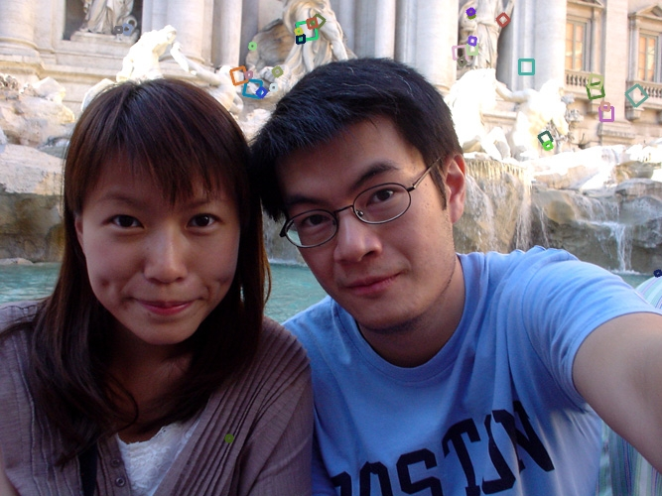
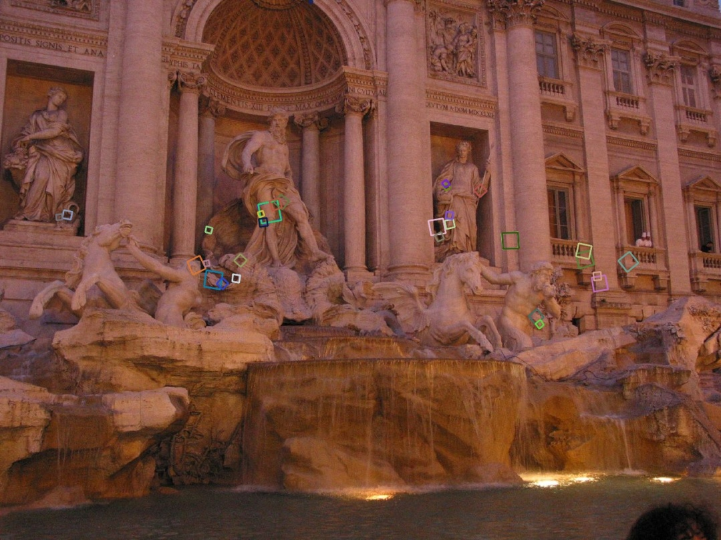
Summary of SIFT
Extraordinarily robust matching technique
Can handle changes in viewpoint
Up to about 60 degree out of plane rotation
Can handle significant changes in illumination
Sometimes even day vs. night (below)
Fast and efficient—can run in real time
Lots of code available
http://people.csail.mit.edu/albert/ladypack/wiki/index.php/Known_implementations_of_SIFT

Slide 23
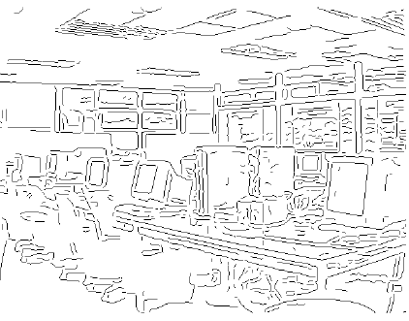
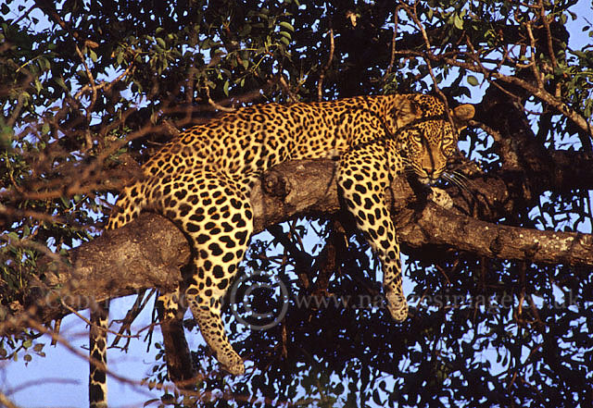
What about internal structure?
Edges & Corners convey boundary information
What about interior texture of the object?

Slide 24
Slide Credits
David A. Forsyth - UIUC
Fei Fei Li - Stanford
Svetlana Lazebnik – UIUC
Rob Fergus – NYU

Slide 25

Questions

